Slide 2
Operating System II CMP 321 Context Switching and Dispatching
Egena Onu, PhD.
Computer Science Department,
Bingham University.

Slide 3
Process → Task → Thread
The terms process and task are often used interchangeably.
Thread = lightweight process: a process that shares memory space with other processes.
Thread – Process Similarities:
Have their own private register set (including PC) and stack.
Have their own logical control flow.
Can run concurrently.
Are context switched.
Have a state (ready, running, etc.).
Can create child threads/ processes.
threads
process

Slide 4
Process → Task → Thread
Thread – Process differences:
A single process can have multiple threads (peer threads)
Threads of a process are much like child processes of the process, but sharing memory space with parent process.
Peer threads share code, data, file descriptors and process priority, while processes (typically) do not.
All threads can access all address in the process memory space.
A thread can access another (peer) thread’s stack.
Threads are somewhat less expensive than processes.

Slide 5
Process → Task → Thread
Usual terminology
Process is always something big
Task
same with process in big systems
same with thread in small or embedded systems
Embedded systems
There is one process: the kernel
Tasks = threads

Slide 6
Concurrent Thread Execution
Two threads run concurrently (are concurrent) if their logical flows overlap in time.
Otherwise, they are sequential.
Examples:
Concurrent: A - B, A - C
Sequential: B - C
Thread A
Thread B
Thread C
Time

Slide 7
Why multiple processes?
Processes help us manage timing complexity:
multiple rates
multimedia
automotive
asynchronous input
user interfaces
communication systems
Life without processes: Code turns into a mess:
interruptions of one task for another
spaghetti code
A
A_code();
…
B_code();
…
if (C) C_code();
…
A_code();
…
switch (x) {
case C: C();
case D: D();
...
time
B
C
A
C

Slide 8
Multiple Processes
stack
stack
stack
process priority
process priority
...
process priority
CPU registers
CPU registers
CPU registers
Memory: PCBs
}
Processor
context
CPU registers

Slide 9
Context Switching
Context Switching is an OS process management mechanism that allows multiple processes to use a single CPU.
Context Switching stores the status of the executing process so that it be reloaded from the same point from where it was stopped.
Notes:
Context Switching stores the state of the current process, and the state includes the information about the data that was stored in registers, the value of the program counter, and the stack pointer. Context Switching is necessary because if we directly pass the control of CPU to the new process without saving the state of the old process and later if we want to resume the old process from where it was stopped, we won't be able to do that as we don't know what was the last instruction the old process executed. Context Switching overcomes this problem by storing the state of the process.

Slide 10
Context Switching
Multiple processes => CPU’s replacement of the currently running process with a new one (called “context switching”)
Simply saves the old context and “restores” the new one:
Current process is interrupted
Processor’s registers for that particular process are saved in a process-specific table - PCB stored
Process is placed on the “ready” list to wait for the next time it gets the CPU
process 1
PC
registers
process 2
...
CPU
memory

Slide 11
Context Switching
Process control block stores memory usage, priority level, etc. – PCB updated
New process’s registers and status are loaded into the processor
New process starts to run
This generally includes changing the stack pointer, the PC and the PSR (program status register)
Note: 3 PCs involved in a context switch: of the OS kernel, and of the 2 switching processes

Slide 12
Multitasking Systems
Batch system: operating system technique where one job completes before the next one starts
Multitasking: operating system technique for sharing –in time- a single processor between multiple processes (giving the impression that they are executed in parallel)
Multiprocessing: processes really executed in parallel, in multiple CPUs

Slide 13
Multitasking Systems
Features provided by the OS to facilitate multiple processes running on the same CPU:
Context switching : alternating between the different processes or tasks
Scheduling : deciding which process to run next
Various scheduling algorithms
First-come first-served
Shortest job first
Round-robin
Priority-based
Critical sections : providing adequate memory-protection when multiple tasks/processes run concurrently
Various solutions to dealing with critical sections

Slide 14
Cooperative Multitasking
if (x>2)
sub1(y);
else
sub2(y);
cswitch();
proc(a,b,c);
proc(r,s,t);
cswitch();
do-something;
process2
process1
save_state(current-proc);
p=choose_next_process;
load_and_go(p);
Multi-tasking:
Cooperative multi-tasking
Preemptive multi-tasking
Cooperative multi-tasking:
running process decides (voluntarily) when to yield the CPU
then the scheduler chooses which process to run next.
scheduler

Slide 15
Cooperative Multitasking
if (x>2)
sub1(y);
else {
sub2(y);
cswitch();
}
proc(a,b,c);
Problems with co-operative multitasking:
Programming errors can keep other processes out:
process never gives up CPU;
process waits too long to switch, missing input.
process1

Slide 16
Preemptive multitasking
Most powerful form of multitasking:
OS controls when context switches should take place;
then the OS scheduler chooses which process to run next.
Use timer to call OS to switch contexts.
Preemptive OS kernel: a kernel that can take a process out of the processor (before that is finished)
interrupt
CPU
timer

Slide 17
Multitasking
In both cooperative and preemptive multitasking cases:
Hardware interrupts might cause a process to yield the CPU prematurely
The OS Scheduler decides the next process to run on the CPU, and starts this next process
How and when can a process get control of the processor (to be executed)?
Periodical Clock interrupts invoke the OS.
The corresponding period is called time-slice / time-quantum.
It is during a clock interrupt that the kernel (scheduler) can determine if another process than the currently executed should run; in that case a context switch has to be performed.
A process can be stopped at some point so that other code can run on the CPU
A (time-slice) clock interrupt can cause a preemptive kernel to reschedule the CPU
An interrupt can cause the processor to run an interrupt handler

Slide 18
Triggers of Context Switch
There are three main triggers for context switching:
Multitasking
Interrupt Handling
User and Kernel switching mode

Slide 19
Triggers of Context Switch
Multitasking
In the multitasking environment, when one process is utilizing CPU, and there is a need for CPU by another process, Context Switching triggers.
Context Switching saves the state of the old process and passes the control of the CPU to the new process.

Slide 20
Triggers of Context Switch
Interrupt Handling
When an interrupt takes place, the CPU needs to handle the interrupt.
Before handling the interrupt, the Context Switching gets triggered, which saves the state of the process before handling the interrupt.

Slide 21
Triggers of Context Switch
User and Kernel Mode Switching
The user mode is the normal mode in which the user application can execute with limited access, whereas kernel mode is the mode in which the process can carry out the system-level operations that are not available in the user mode.
Whenever the switching takes from user mode to kernel mode, mode switching triggers the Context Switching, which stores the state on an ongoing process.

Slide 22
When Can A Context-Switch Occur
Time-slice
Time-slicing
Time-slice (or quantum): period of time a task can run before a context-switch can replace it
Driven by periodic hardware interrupts from the system timer
During a clock interrupt, the kernel’s scheduler can determine if another process should run and perform a context-switch
Of course, this doesn’t mean that there is a context-switch at every time-slice!
Context switches
interrupt
Context switches

Slide 23
When Can A Context-Switch Occur
Preemption
Currently running task can be halted and switched out by a higher-priority active task
No need to wait until the end of the time-slice

Slide 24
Context Switch Overhead
How often do context switches occur in practice?
It depends on how often users interact, how many processes need attention, etc.
System context-switch vs. processor context-switch
Processor context switch = amount of time for the CPU to save the current process’s context and restore the next process’s context
System context switch = amount of time from the point that the process was ready for context-switching to when it was actually swapped in
Hence, System CS = Processor CS + …

Slide 25
Context Switch Overhead
System context-switch time is a measure of responsiveness
How long does a system context-switch take?
Time-slicing : time-slice period (at least one) + processor context-switch time
Preemptive : a processor context-switch time
Preemption is mostly preferred because it is more responsive (system context-switch = processor context-switch)
Non-zero context switch time can push limits of a tight schedule.
In practice, OS context switch overhead is small.

Slide 26
Advantage of Context Switching
Context switching is used to achieve multitasking i.e. multiprogramming with time-sharing.
Multitasking gives an illusion to the users that more than one process are being executed at the same time. But in reality, only one task is being executed at a particular instant of time by a processor.
Context switching occurs very fast that the user feels that the CPU is executing more than one task at the same time.

Slide 27
Disadvantage of Context Switching
The disadvantage of context switching is that it requires some time for context switching i.e. the context switching time.
Time is required to save the context of one process that is in the running state and then getting the context of another process that is about to come in the running state.
During that time, there is no useful work done by the CPU from the user perspective therefore, context switching is pure overhead in this condition.

Slide 28
Dispatcher
The dispatcher is an OS module that gives control of the CPU to the process selected by the short term scheduler.
Dispatch
New
Ready
Run
Termination
Waiting

Slide 29
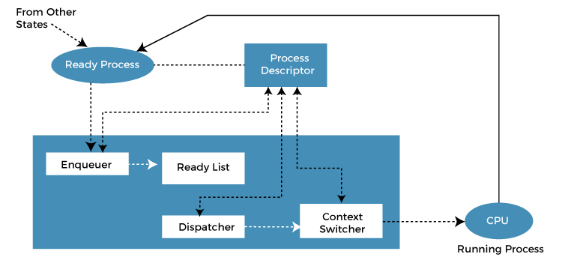
Dispatcher

Slide 30
Dispatcher Roles
The roles of the dispatcher include:
Switch context.
Switching to user mode.
Jumping to the proper location in the user program to restart that program.

Slide 31




Dispatch Latency
Dispatch Latency is the time it takes for the dispatcher to stop one process and put another in the running state from the ready queue.
$$P_{0}$$
Executing
Save $P_{0}$ state to ${PCB}_{0}$
Dispatch latency
Restore $P_{1}$ state from ${PCB}_{1}$
$$P_{1}$$
Executing

Slide 32
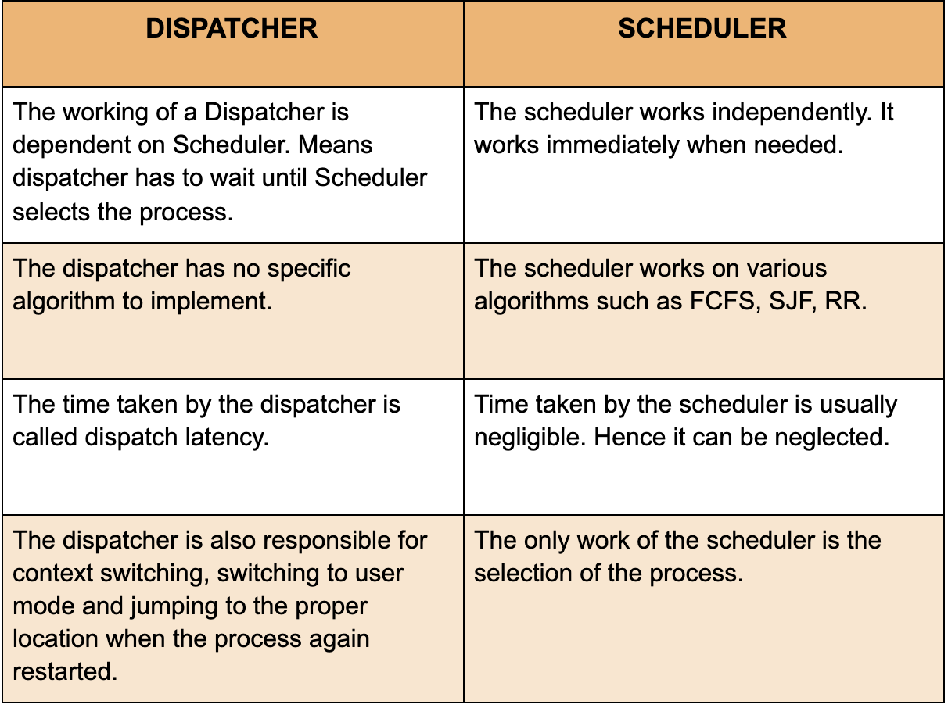
Difference Between Scheduler and Dispatcher

Slide 33
Questions!!!

